Slide 1
Solar Car Challenge Telemetry
Jarrett Dunn

Slide 2
Agenda
Sources
Communications
Sensors
Practical Example

Slide 3
What to look for in a Source
Documentation
Reliability
Customer support
Lead time

Slide 4
Sources
Adafruit
Reliable
Excellent documentation
Fast shipping
Expensive!!!
Sparkfun
Reliable
Good tutorials
Expensive
Aliexpress
High Failure rate
Long shipping times
Little to no documentation
Cheap!!
Ebay
Unknow sources
Questionable quality
Cheap
*** These are Jarrett’s opinions. The Solar Car Challenge does not endorse any of these companies or products***

Slide 5
Essential Parts
Sensors
Processor
Transmission Method
Storage Method
Display

Slide 6
Sensors
Voltage
ADS1115 ($15 Adafruit)
16 bit
Programmable gain
Speed ($40 Adafruit)
MTK3339
Temperature ($5 Adafruit)
MCP9808
Current
Hall Effect ($30 Aliexpress)
Shunt ($22 Digi-Key)

Slide 7
Micro Controllers
Pros
Cons
Real time controllers
Single loop
Cheap
Easy to program
Lowe Power usage
Real time controllers
Single loop
Low Speed
8-120 Mhz
Limited Memory

Slide 8
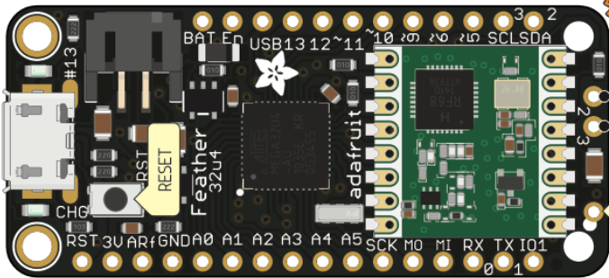
Micro Controllers
Examples
Arduino
ARM and AVR processor family
Parallax
Basic Stamp
Propeller
Texas Instruments
MSP430
Simple Link

Slide 9
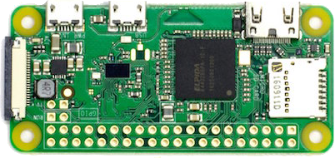
Micro Computer
Pros
Cons
Fast 1 GHz+
Large Memory
Large Storage
Multiple Threads/Processes
Expensive
Large power requirement
Multiple threads/processes
Difficult to program
Multiple threads/processes

Slide 10
Processor
Raspberry Pi Zero W ($10 Multiple)
I2C Network
Serial Communications
Built in Wifi
HDMI
Substantial Storage

Slide 11
Transmission
Wifi
Cell

Slide 12
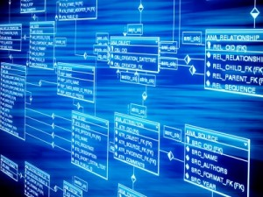
Storage
Hosts
Database

Slide 13
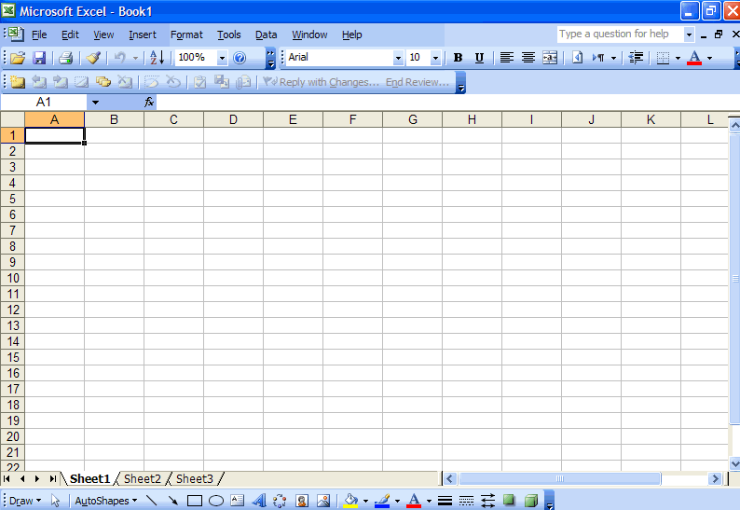
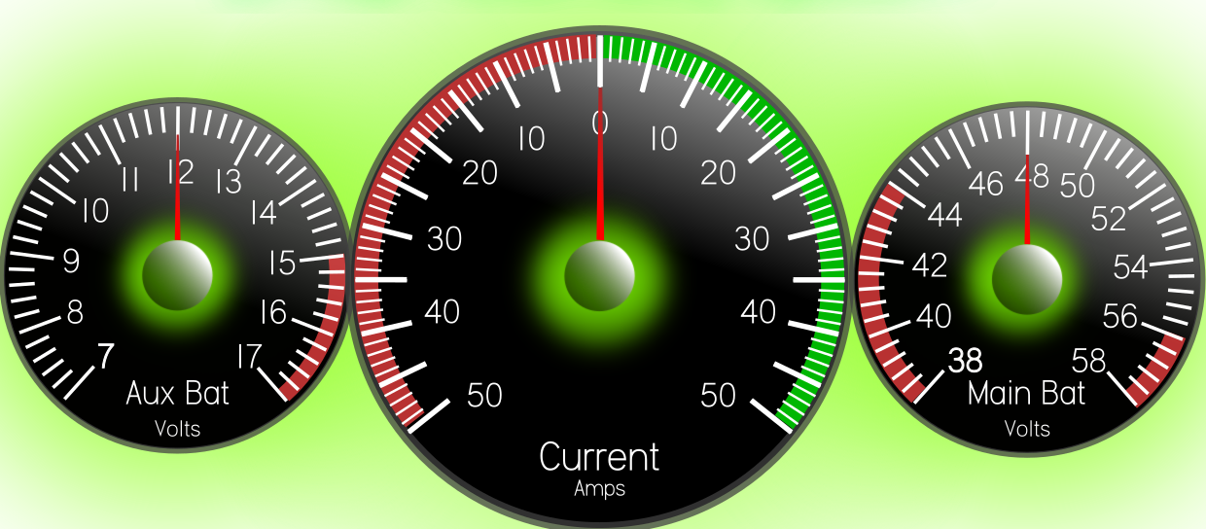
Display
Database

